Slide 1
AWS DeepRacer 2025 Competition

Slide 2
Competition Overview
01

Slide 3
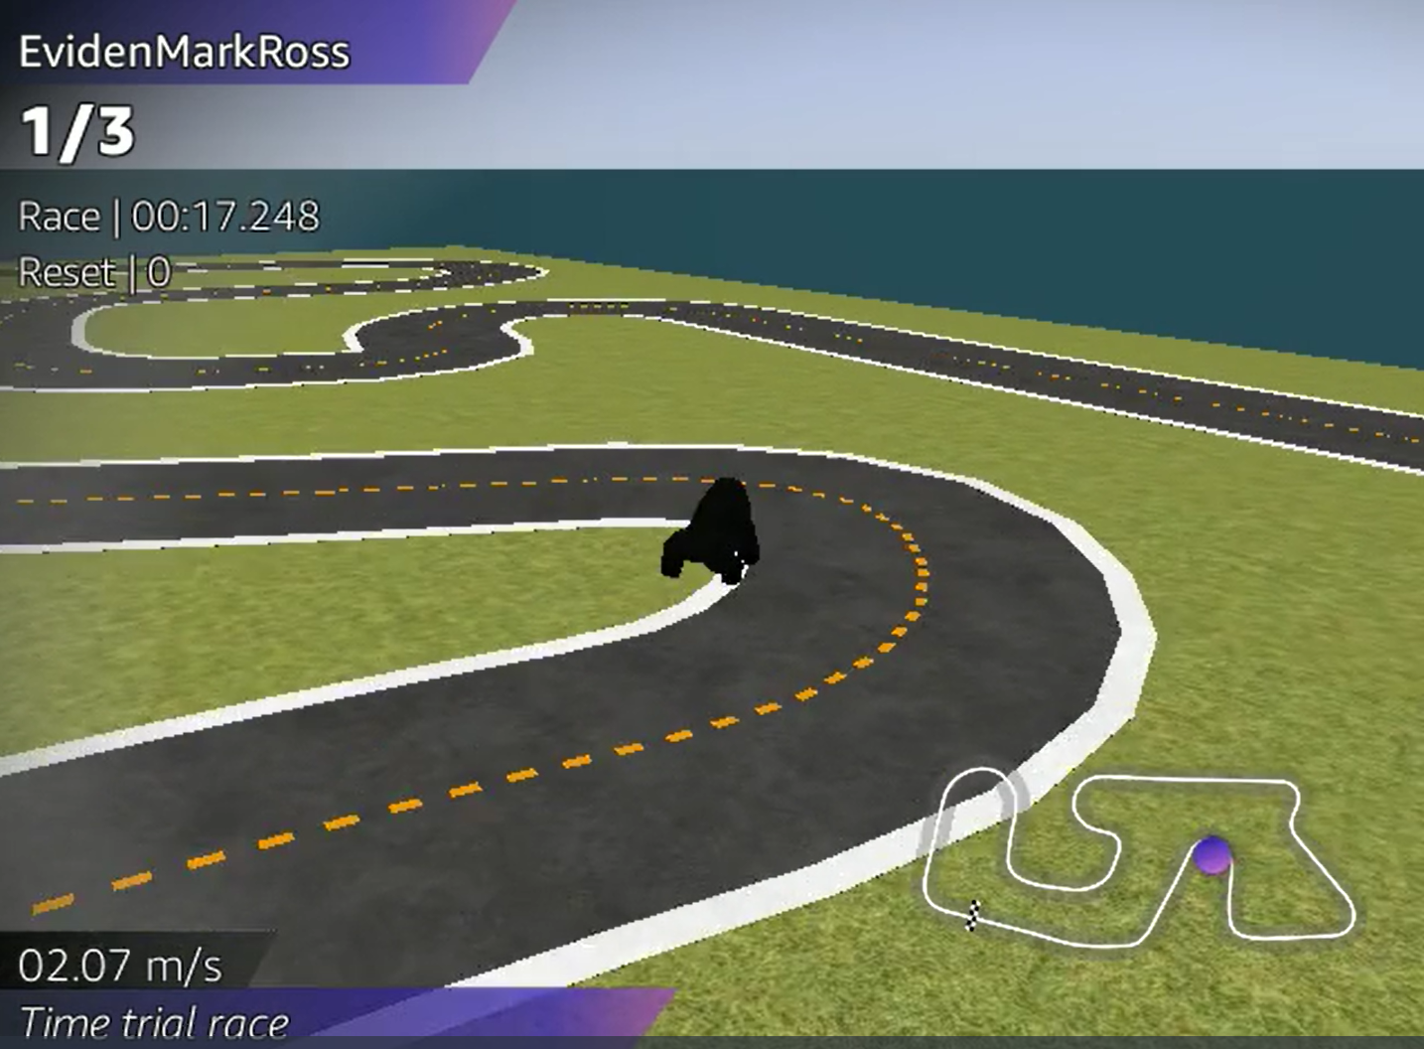
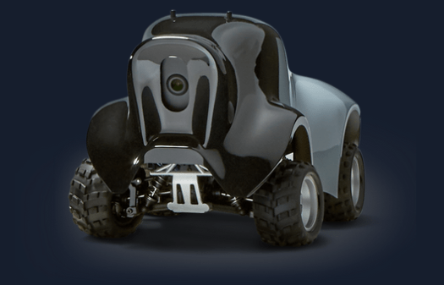
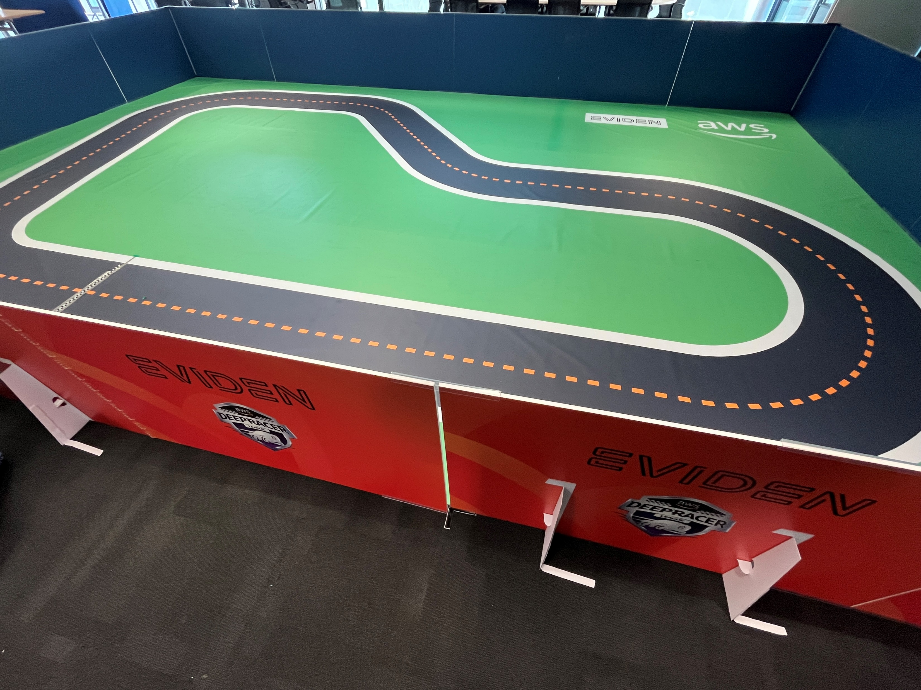
Atos Group AWS DeepRacer 2025 League
What is DeepRacer
AWS DeepRacer is a 1/18th scale autonomous race car
It is a complete program that has helped thousands of employees in numerous organizations begin their educational journey in machine learning through fun and racing rivalry
You train DeepRacer in virtual environments with re-enforcement machine learning and then race them in either virtual or physical worlds, or both

Slide 4

Atos Group AWS DeepRacer 2025 League
Competition overview and learning opportunities
Global league open to all Atos Group employees​
Regional virtual racing with top racers in each region racing on physical tracks
Bydgoszcz​
London
Paris
Pune​
Regional winners to have a final race to crown our global winner
Have fun, learn and compete against colleagues
AWS accounts and credits will be provided to participate
Assistance to participate will be provided
Limited places – don't delay, register today!
https://forms.office.com/e/eJfWaSPxEt
Get hands on with as little or as much of these areas as your time allows
AWS Cloud
Cost discipline
Data Analytics
Jupyter Notebooks
Machine Learning
Reinforcement learning
Programming
Python
EC2 (including Spot Instances)
S3
CloudFormation
Infrastructure as Code
Reward function strategy
Log Analysis
Git
Hyper parameter optimisation
Python frameworks for data manipulation
numpy, plotly, pandas
GenAI

Slide 5
Atos Group AWS DeepRacer 2025 League
Competition Format
London
Paris
Bydgoszcz
Pune
Develop your models virtual
Fastest racers get to take part in physical racing held in chosen cities
Each physical race winner takes part in the global final
The global winner is invited to attend re:Invent (subject to local travel and time booking agreement and eligibility to enter USA)
Winner will be able to attend many learning sessions at re:Invent
There may be an expectation to help for some hours at the Atos booth
There is no DeepRacer competition at re:Invent in 2025
Winner
Winner
Winner
Winner
Global Final
Winner (ESTA eligible or existing VISA)
re:Invent
(1st – 5th Dec)

Slide 6
Overview of DeepRacer
02

Slide 7
DeepRacer – Reinforcement Learning
Reinforcement Learning in the Broader AI context
Supervised Learning
Example driven training
Label data for the machine to learn from
Useful when you know what you’re looking for
Unsupervised Learning
No labels on training data
Let the machine find patterns you weren’t even aware of
Useful to find unknown trends and correlation
Reinforcement Learning
Learn through trial and error
Consequences (good and bad) to actions within an environment
Artificial Intelligence
Machine Learning
Reinforcement Learning
Supervised Learning
Unsupervised Learning

Slide 8
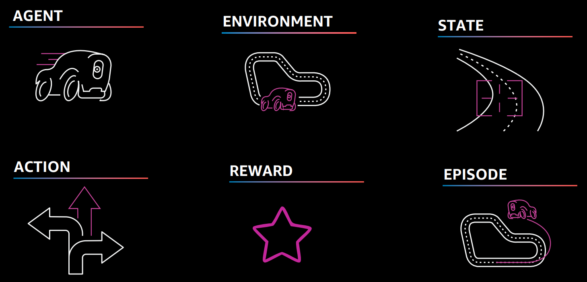
AWS DeepRacer Learning Terms

Slide 9
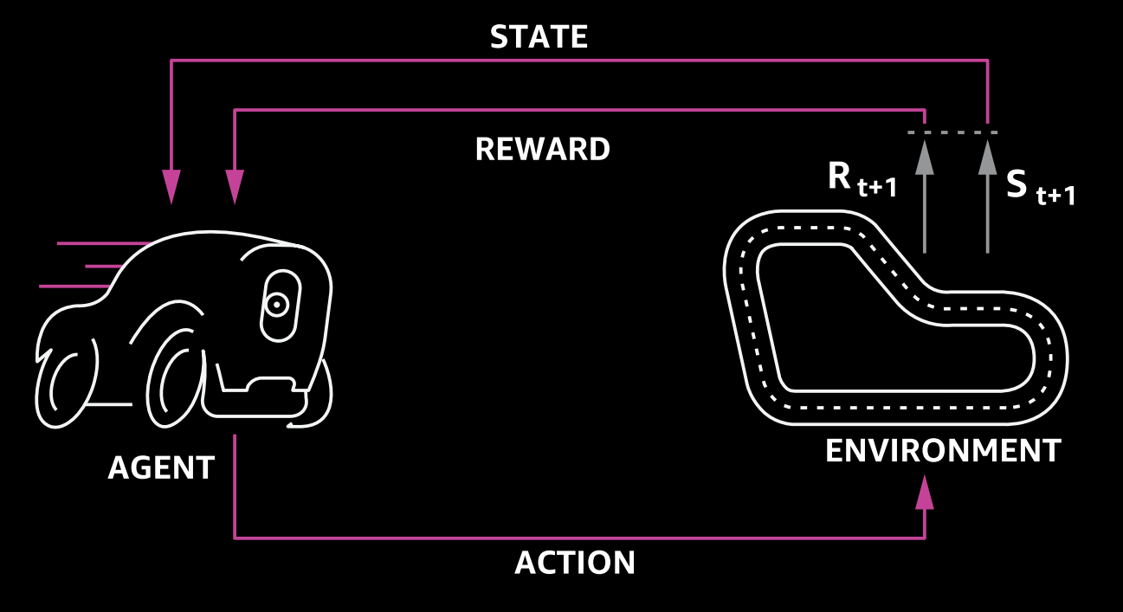
How does learning happen?

Slide 10
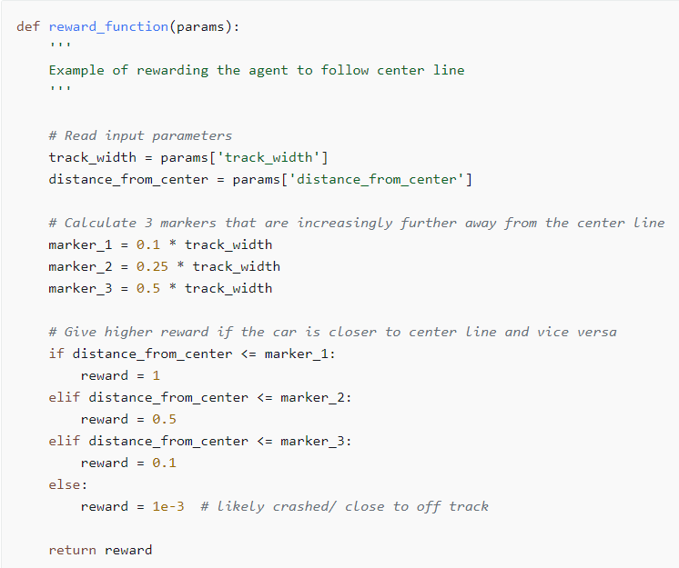
Using a reward function to incentivise behaviour
Follow the centre line example – reward is calculated at each ‘step’ (15 times per second)
1e-3
0.1
0.5
1
0.5
0.1
1e-3

Slide 11
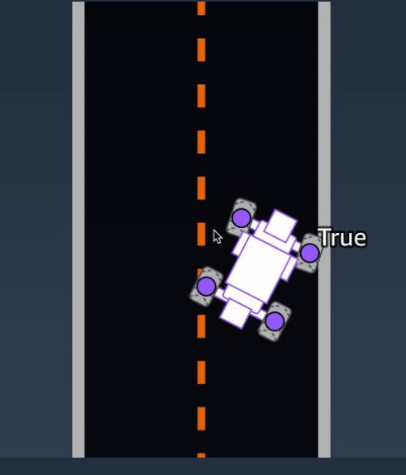
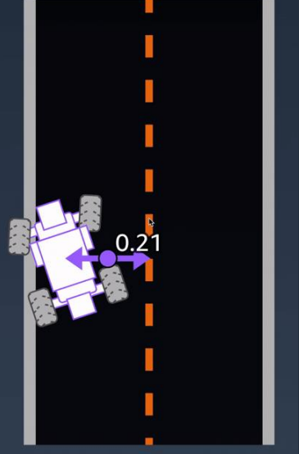
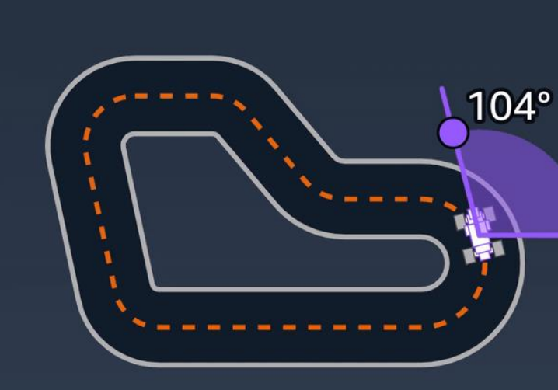
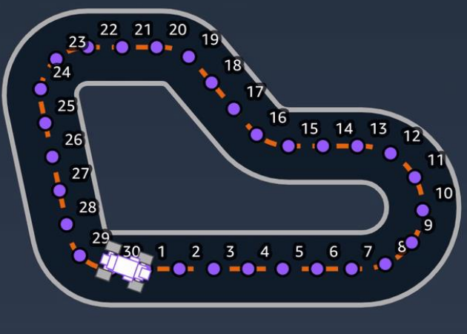
Example Parameters
all_wheels_on_track
distance_from_center
heading
waypoints
A full list of parameters is provided here - https://docs.aws.amazon.com/deepracer/latest/developerguide/deepracer-reward-function-input.html

Slide 12
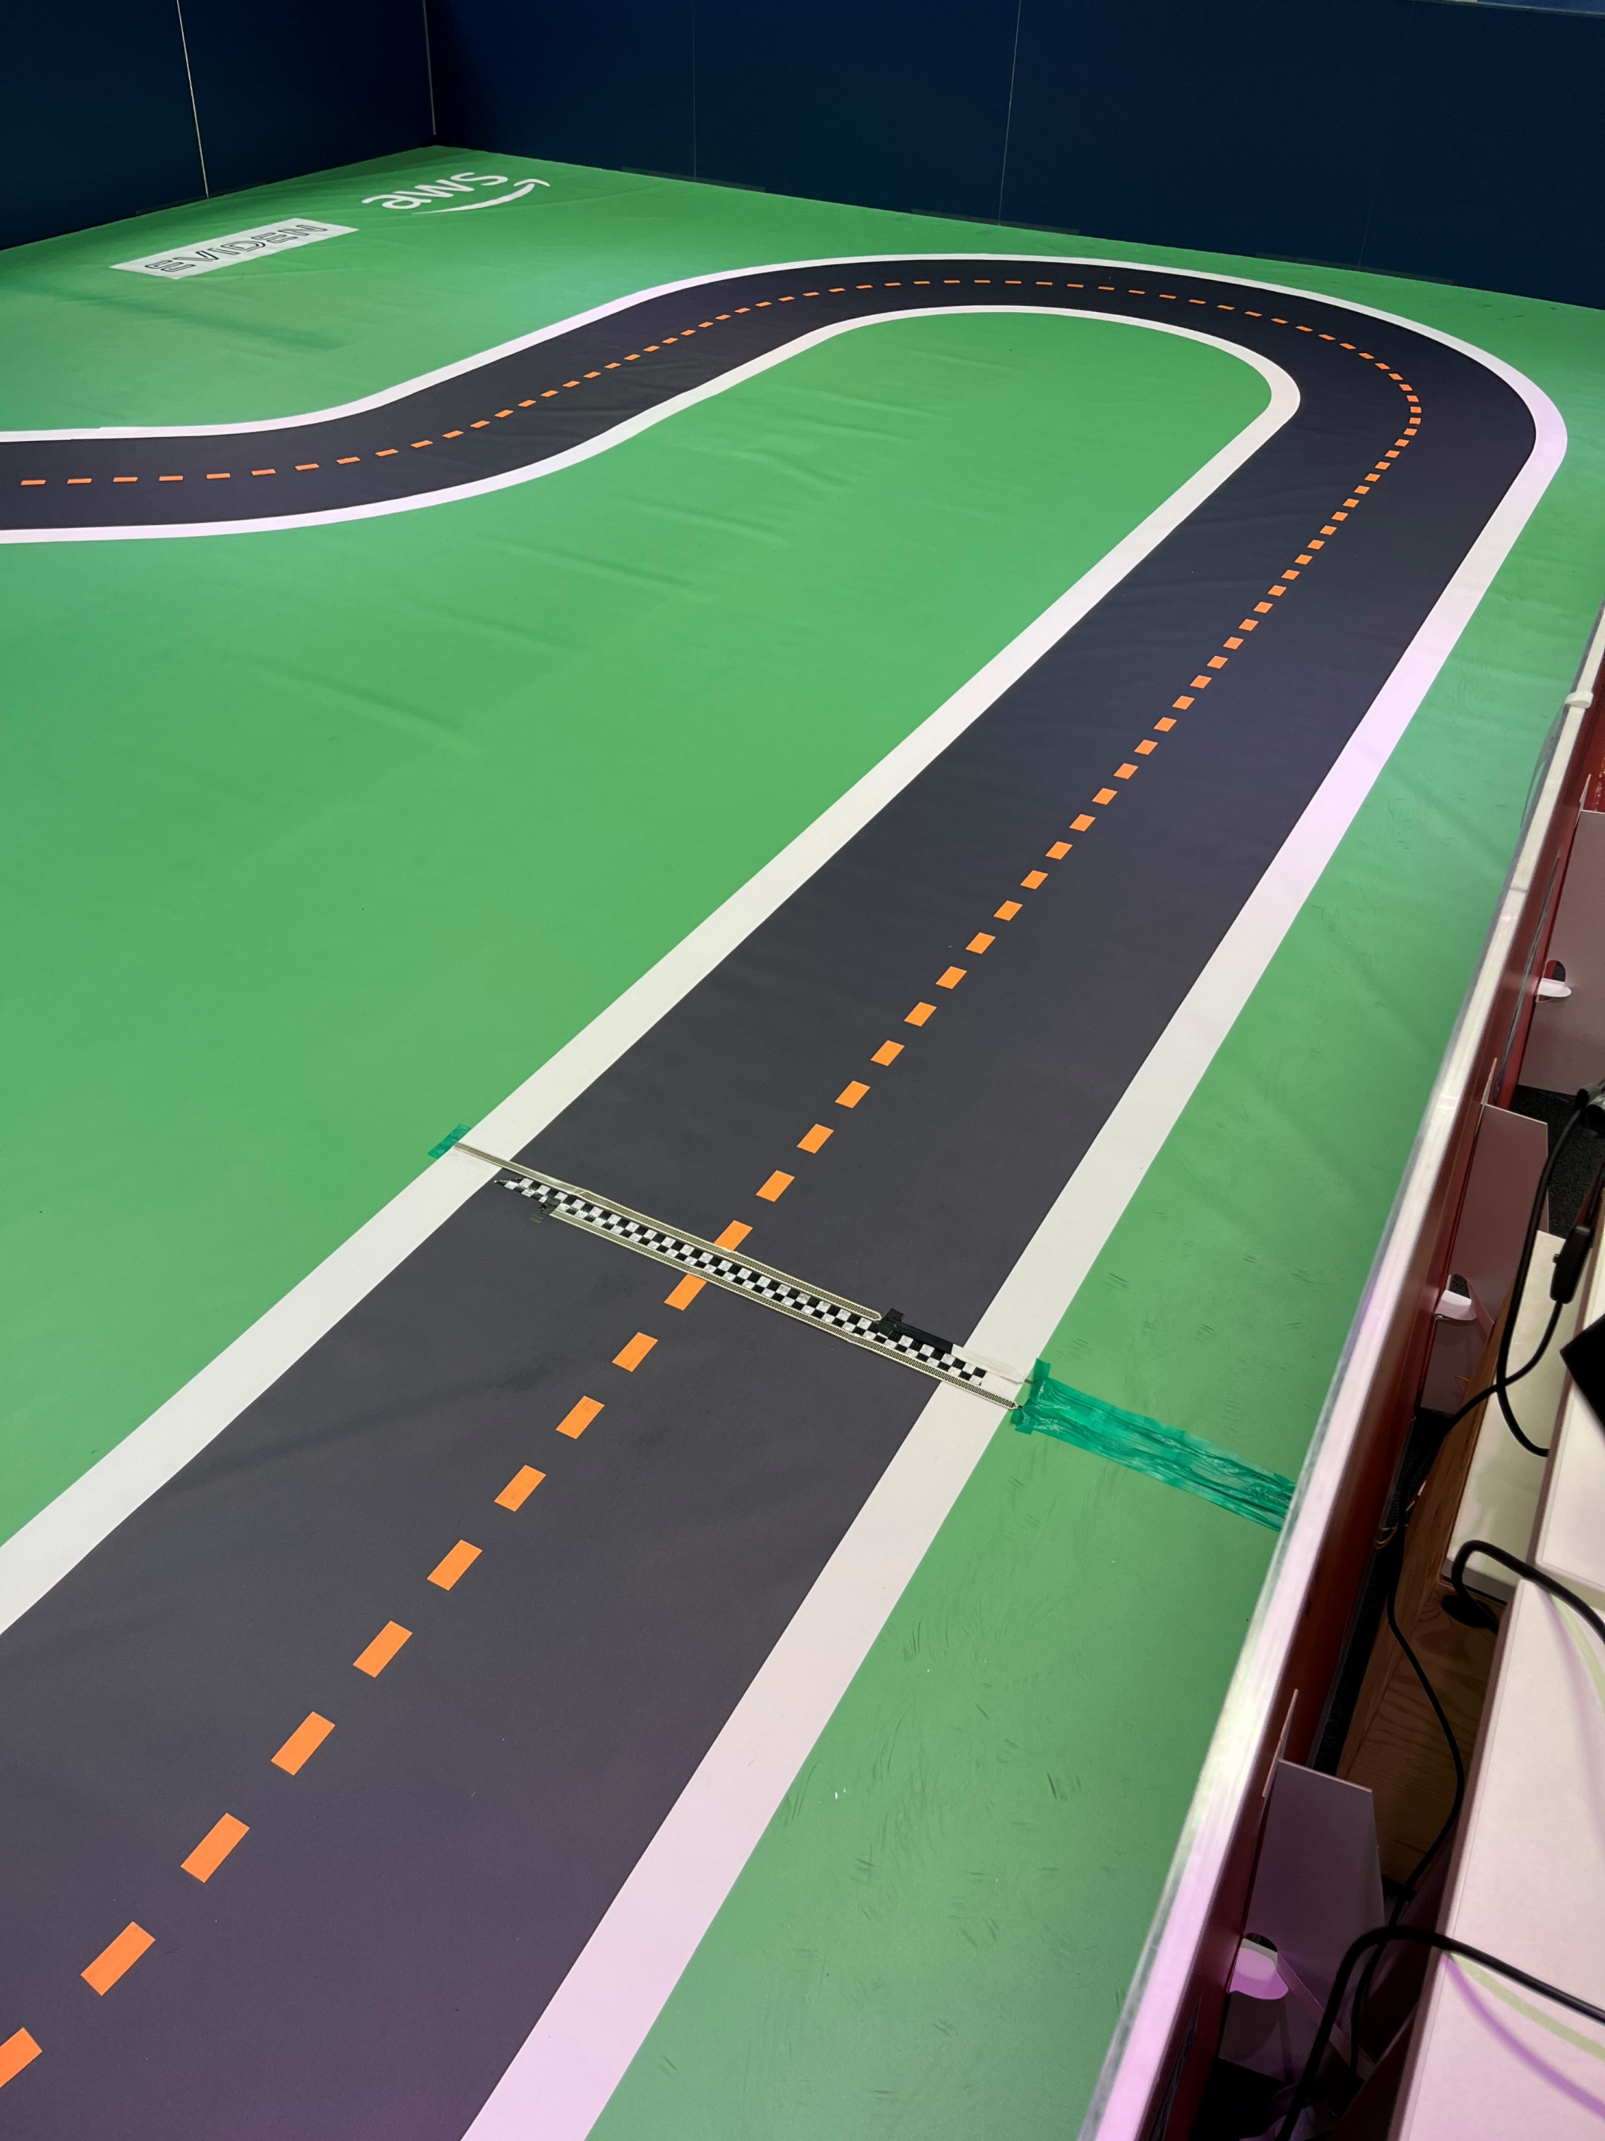
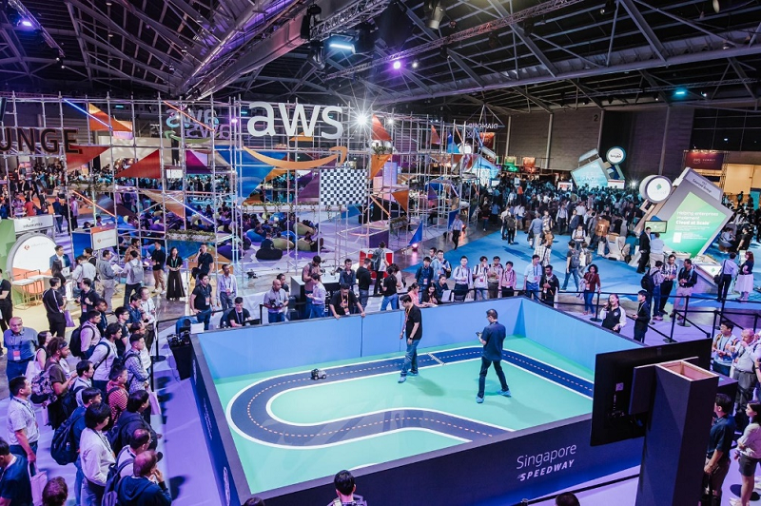
Physical Racing Challenges
Simulation to real world (sim2real) comes with its own challenges
The simulated world is sterile
The real world is not sterile, every physical event is likely to have: -
Differing lighting conditions
Differing shadows being cast
People walking around the outside of the track that could be visible over the barriers
Wrinkles in the track
Too much training in the sterile, virtual world, can lead to a machine learning problem of being ‘overfit’ (model fits the training data but not real data)
In the context of DeepRacer this means: -
The car’s model has become extremely finely tuned to its sterile, virtual world
It’s not able to ‘generalise’ for conditions it’s not seen before
You may struggle to complete a lap, let alone set a good time
A model that’s good virtually isn’t a guarantee of good physical performance

Slide 13
Physical Racing – Tips
Training for the finals
Do not overtrain your model
You have a choice to use multiple models you use on the day
You could choose to try completely different strategies
Or you could use multiple models of the same strategy
E.g. One from as soon as the model hits 100% in eval
A clone where you try a little bit more training until it is consistently 100% in eval
Or somewhere in between… it’s up to you!
You’ll have two separate attempts
You can use one model per attempt for the full time with no loss of time
You can switch models during one of your attempts, this takes approximately 5 seconds and your time on track will continue to count down
Choose models that are consistent in evaluation – if it’s only completing 1/3 laps it’s probably not stable
Bias your training for stability over speed for physical racing

Slide 14
Training Opportunities
03

Slide 15
AWS Training and Certification
AWS Training and Certification is key to our success – skilled people able to sell and deliver to clients
It also provides funding by way of AWS credits for every person who passes an exam and is registered to Atos Group companies
This competition is being funded via these credits, and it also funds things like training subscriptions
Help us to put on future events by gaining AWS certifications
Please ensure your certifications are shared with Atos or Eviden’s APN registration
Please consider gaining or renewing a certification to help fund future initiatives
Just getting started or in a ‘non-technical’ role? – AWS Cloud Practitioner is perfect for you and AWS provide a free course, or AI Practitioner for AI specific learning, again AWS provide a free course
Want to take the next steps? Choose an associate level certification as a Developer, SysOps Administrator, Solution Architect or Data Engineer – ACloudGuru or SkillBuilder courses available
Got a reasonable amount of AWS experience and really want to stand out? Choose a professional level certification as a DevOps Engineer or Solution Architect or a specialty level certification as a Network Engineer, Machine Learning Specialist, Security Specialist – ACloudGuru or SkillBuilder courses available
Find free Exam Vouchers and ACloudGuru via MyLearning

Slide 16
Training to fill knowledge gaps
Training Area | Format (examples)
Introduction to the program and DeepRacer | Internal webinar
Introduction to AWS console | Free Skills Builder Course
Introduction to Machine Learning | Free Skills Builder Course
Working with Git | ACloudGuru
Introduction to Python scripting | Free LearnPython.org course
Introduction to Jupyter Notebooks | Free Udemy Course
Getting started with CloudFormation | ACloudGuru or Free Skills Builder Course
How to set up an AWS billing and budget alert | Free ACloudGuru video
Understanding AWS Service Quotas | ACloudGuru or Free Online AWS Video
AWS DeepRacer workshop for Console Users | AWS self paced workshop
Introduction to DeepRacer on the Spot and how to use it within our environment | Internal webinar or free online videos
Introduction to DeepRacer Analysis | Internal webinar
Create and improve your models using AWS PartyRock | Self-paced usage of: - PartyRock DeepRacer Model Builder PartyRock DeepRacer Optimiser
Create a DeepRacer Chatbot using Bedrock GenAI | AWS self paced workshop (important – complete cleanup steps listed afterwards)

Slide 17
DeepRacer Console User Instructions
04
Section not applicable to DeepRacer on the Spot users

Slide 18
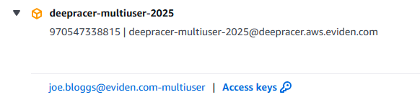
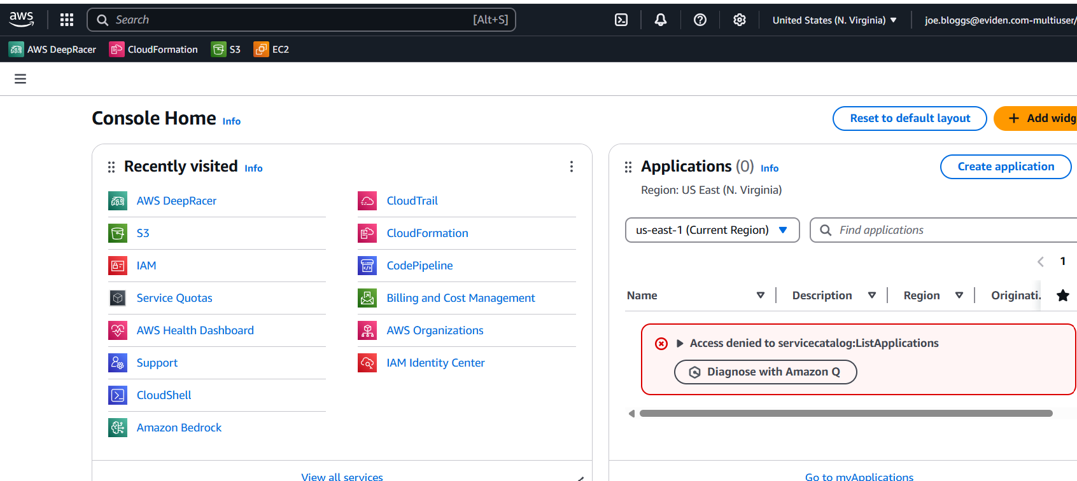
Sign-in to AWS
Navigate to https://deepracer-aws-eviden.awsapps.com/start#/ and login with your Atos (i.e. atos.net email address) single sign-on credentials
Locate the ‘deepracer-multiuser-2025’ account, expand the details with the arrow to the left-hand side and then select ‘<your email address>-2025’ to login
You’ll then be presented with the AWS console, don’t worry if you see some error messages this is likely because your permissions are limited

Slide 19
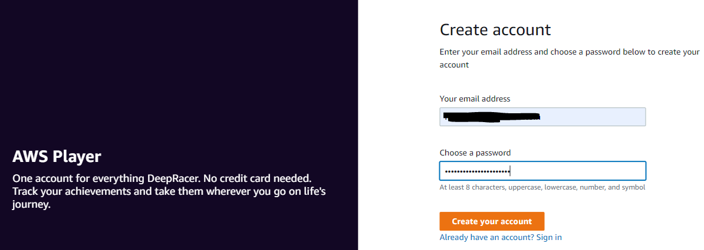
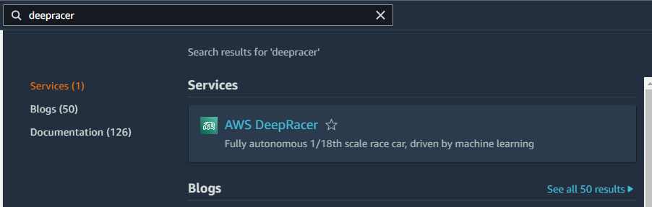
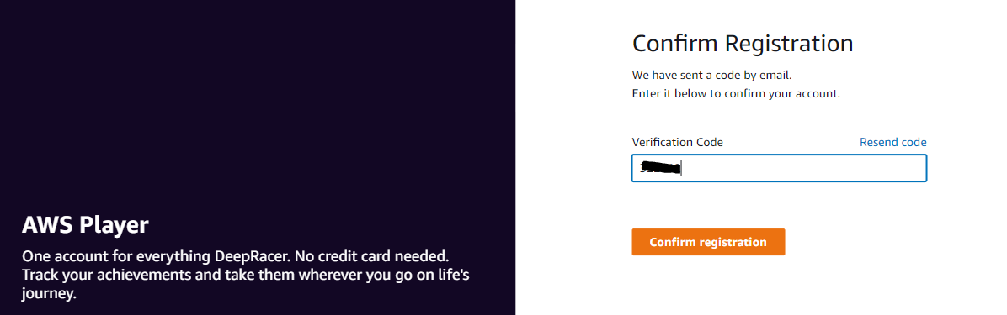
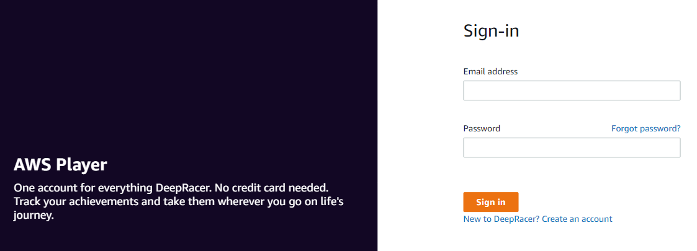
Sign-up for DeepRacer
In the top right corner set region to North Virginia
In the search bar at the top of the console type DeepRacer and select the AWS DeepRacer service
On the DeepRacer sign-in page select ‘New to DeepRacer? Create an Account’ (Note – if you’ve previously registered, you can login with the same details)
Create your DeepRacer account with your corporate email address
Enter verification code sent via email and then sign-in with your DeepRacer account details

Slide 20
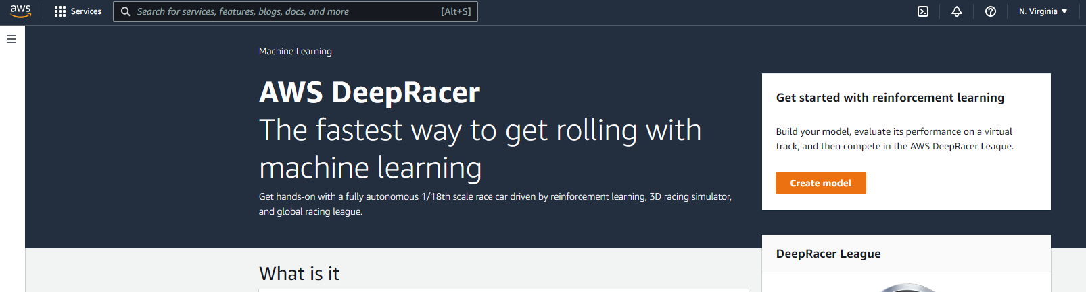
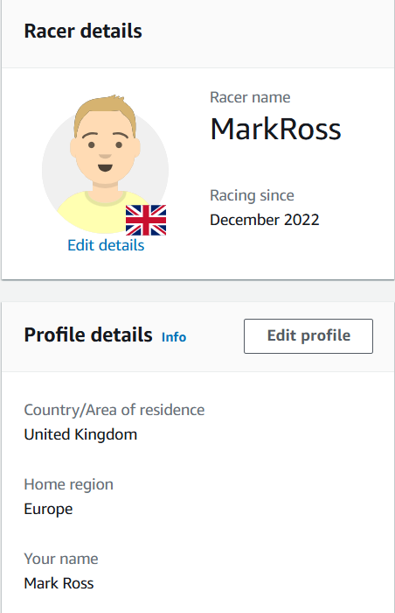
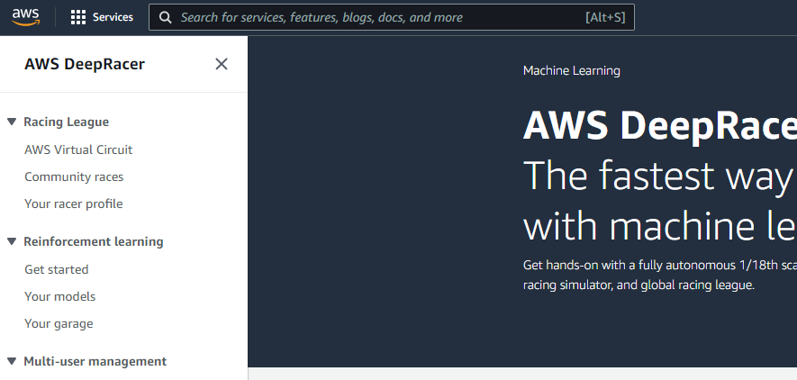
Sign-in to AWS and Sign-up for DeepRacer
If everything is successful you should be presented with the following screen
Select the 3 lines in the top left and choose ‘Your racer profile’
Edit your profile and enter your details (Feel free to use a fun name but we need to be able to identify you if you make the finals)
Modify your avatar if you’d like and add any other requested information

Slide 21
Entering Your Regional Race
Join and submit entries to your regional race
Join only one of these races, depending on which city you registered as your closest
London - https://us-east-1.console.aws.amazon.com/deepracer/home#raceToken/1nQyIukfSSCfpJFKtOp9Sg
Paris – https://us-east-1.console.aws.amazon.com/deepracer/home#raceToken/_W93EWcKSPKhzpq38hOGPA
Bydgoszcz – https://us-east-1.console.aws.amazon.com/deepracer/home#raceToken/O3_6J1PeRl2OU6ZR_sCV5Q
Pune - https://us-east-1.console.aws.amazon.com/deepracer/home#raceToken/u1YRP27fTOSyndnmapUxTw
Important Notes: -
You may submit as many entries to your race as you like
We’re likely to only be able to take the top 30-35 racers forward to the physical racing in each city
The races are average lap format – this rewards stability, rather than a ‘lucky’ single lap

Slide 22
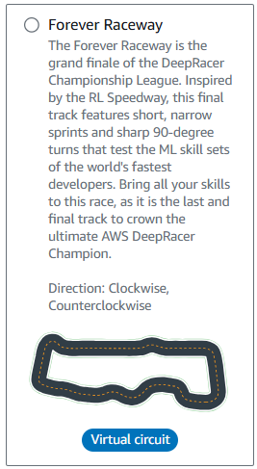
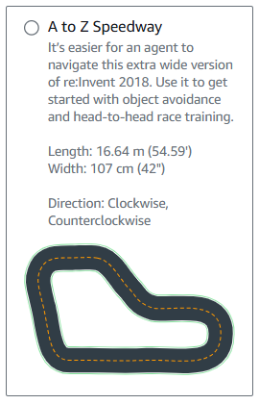
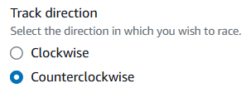
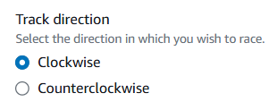
Take part in the competition
The correct tracks for each city are: -
London - Forever Raceway Counterclockwise
All other cities – A to Z Speedway Clockwise
You’ll be limited to 40 hours training and evaluation for the virtual qualifiers (note – it can take time for the quota to be issued after you register, initial default quota is 5 hours, monitor your usage under your profile)
You could train more models for less time
Or fewer models for more time
Recommend you start with an hour or two and then build on that model if it’s going well via cloning to see if you’re along the right path
If you need any support during the competition, please visit the dedicated channel in Teams
Use ‘Get Started’ to the left of the AWS DeepRacer console for a step by step guide to create your first model

Slide 23
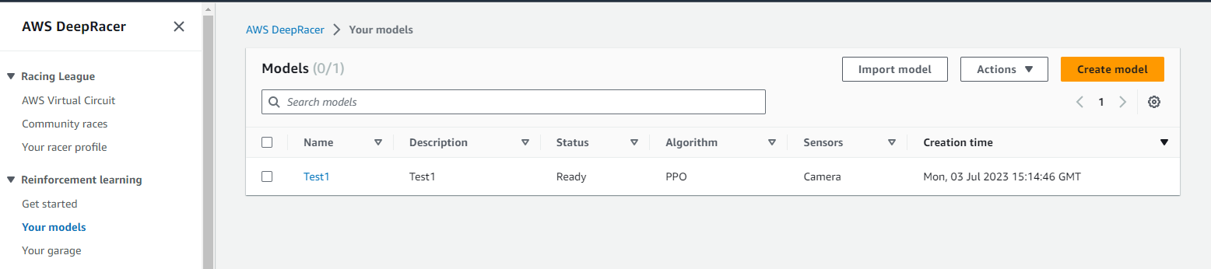
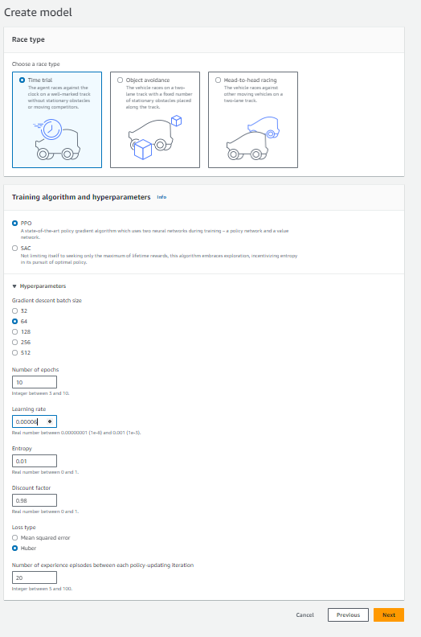
Training a Model
Navigate to the DeepRacer console, login, choose ‘Your Models’ from the left-hand side and select ‘Create Model’
Give your model a name and press ‘View more race tracks’, ensuring you select ‘Forever Raceway’ in Counterclockwise direction (London) or ‘A to Z Speedway’ in Clockwise direction (all other cities)
Choose ‘Time Trial’ and it’s highly recommended you use PPO as the algorithm
Tune the hyperparameters to amend your training. We recommend something in the range of 0.95 – 0.99 for discount factor for most reward functions. Learning rates in the range of 0.00005 – 0.0001 would be more suitable for this race but feel free to experiment

Slide 24
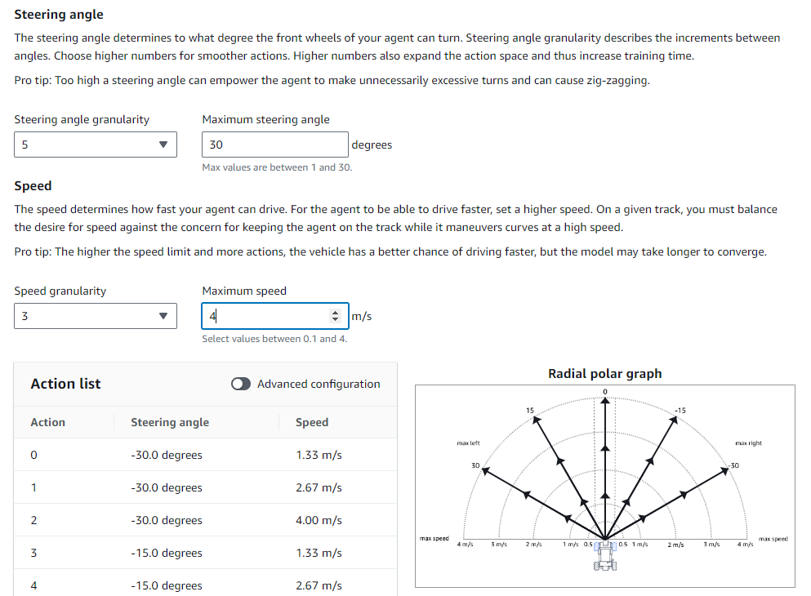
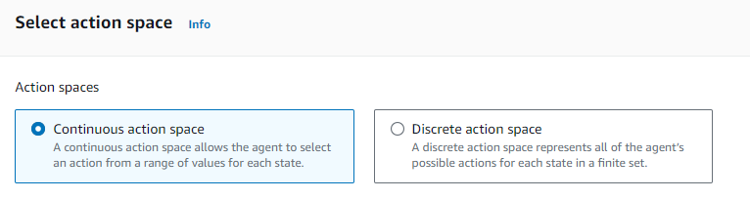
Training a Model Cont…
Choose between Continuous and Discrete action space. Continuous allows all speeds and angles in a range, whilst discrete you select specific actions. Discrete actions makes training quicker
Either choose your ranges and let the console calculate your discrete actions, or toggle ‘Advanced Configuration’ and choose your own
Tip – the car is capable of up to 4m/s, but at larger steering angles it will slide or spin at this speed

Slide 25
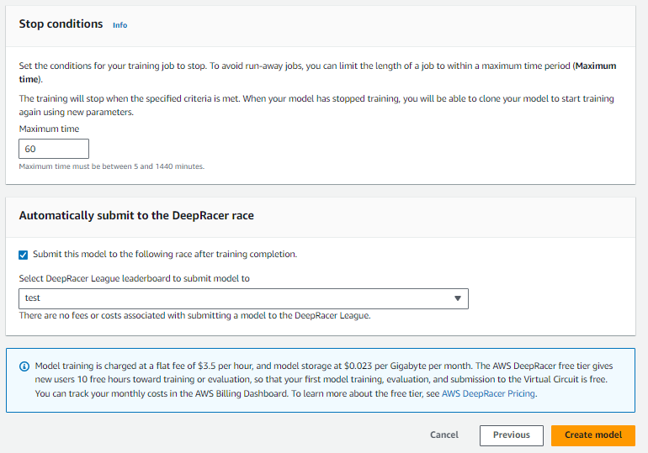
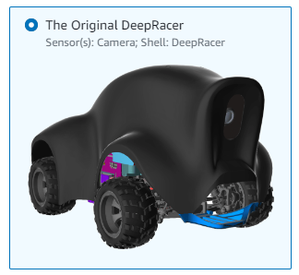
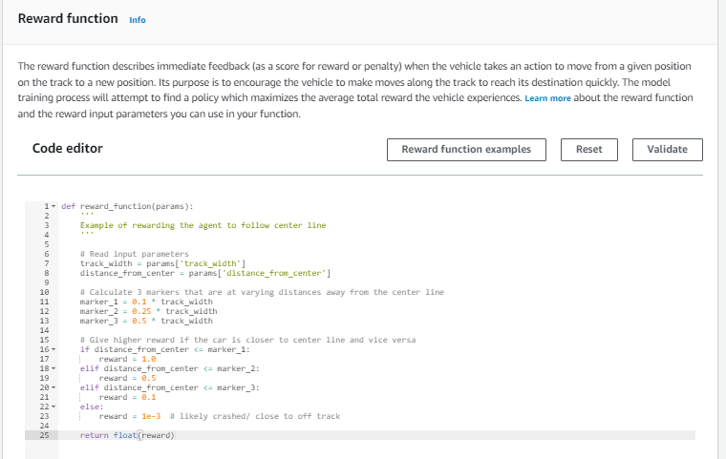
Training a Model Cont…
Leave the default car, which has a single camera. Dual camera and LiDAR is not needed for this race and the in-person race will be with single camera cars. If you train with dual camera or LiDAR they won’t work in the in-person racing
Write your reward function, perhaps taking inspiration from the three time trial examples. References on reward function inputs are here
Choose a time in stop conditions – we recommend start with one hour and then use cloning to see if your model is improving
Change the league selected in the ‘Automatically submit to the DeepRacer race’ to the race for your city and then select ‘Create Model’
You can also choose not to submit the model to the league and do it later via ‘Community Races’ and then ‘Enter Race’

Slide 26
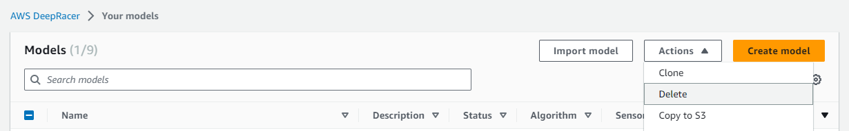
Training a Model Cont…
Checkout ‘Community Races’ to see how your model compares to the competition (note you should only submit to the race in your nearest city)
You’ll be limited to storing 10 models, so if you want to create more than that you’ll need to delete some of your previous ones by selected the model, choosing ‘actions’ and then ‘delete’

Slide 27
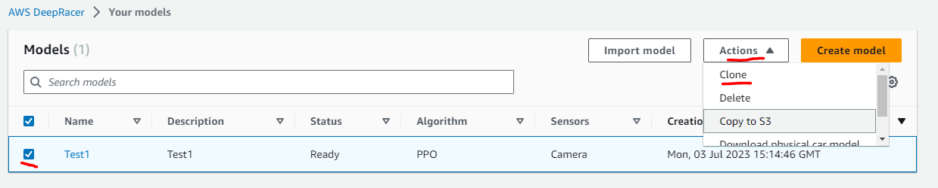
Cloning a Model
Continue training a model that looks promising
Select the model you’d like to continue training from, chose ‘Actions’ and then ‘Clone’
Update the model name (or leave default which adds ‘–clone’ to name of the cloned model), the same track should be pre-selected
Amend the hyperparameters if you desire (you won’t be able to alter the algorithm
Alter the action space if you desire (you won’t be able to add or remove actions, but you can alter speeds or steering if required)
Choose your car as before
Alter your reward function if required
Choose stop time and league as before
Note – the training process creates a model that has learnt to take specific actions based on your previous selections. Cloning a model and then changing too many things at once may lead to worse performance. For fundamental changes it may be better to start training a new model.

Slide 28
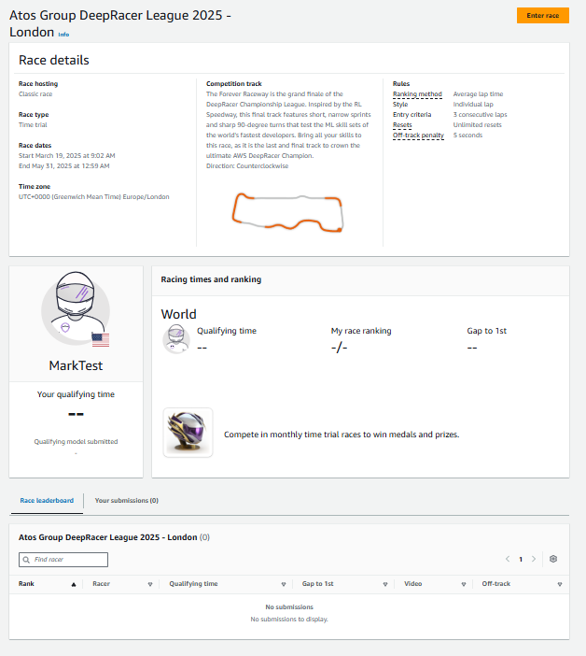
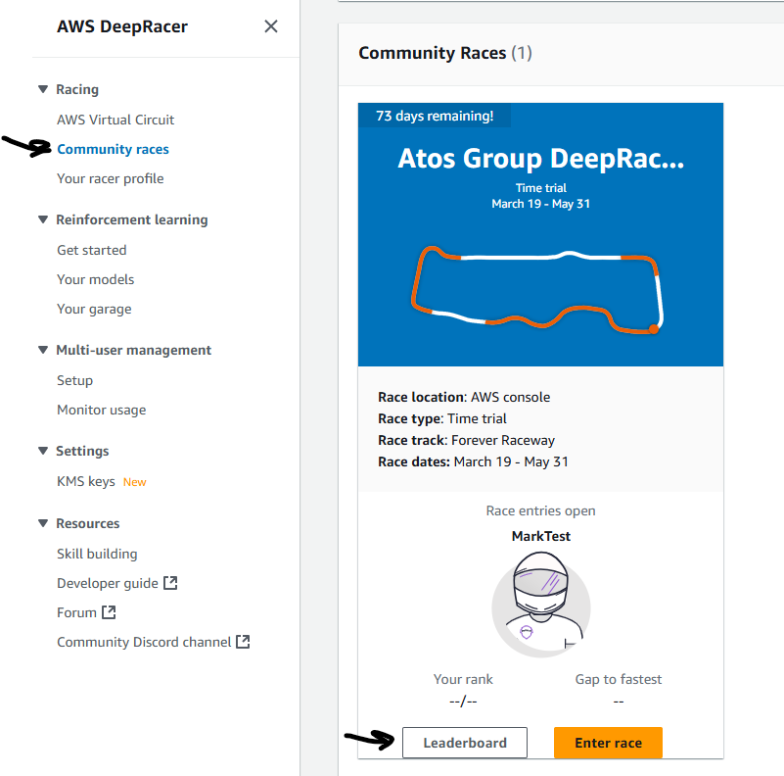
Check your standing in the race
Make sure you’re in the running
Ensure you’ve followed the instructions to join the race in your city
Navigate to ‘Community Race’ in the DeepRacer menu, and then select ‘Leaderboard’ for your race
If you don’t find your name in the leaderboard then use the ‘Enter Race’ button and follow the instructions to submit your model

Slide 29
DeepRacer on the Spot User Instructions
05
Section not applicable to DeepRacer Console users

Slide 30
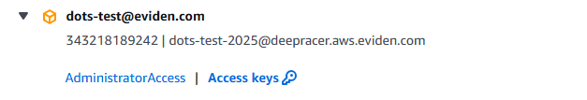
Sign-in to AWS
Navigate to https://deepracer-aws-eviden.awsapps.com/start#/ and login with your Atos (atos.net email) single sign-on credentials
Locate your account, which will be denoted by your email address, expand the details with the arrow to the left-hand side and then select ‘AdministratorAccess’ to login
You’ll then be presented with the AWS console

Slide 31
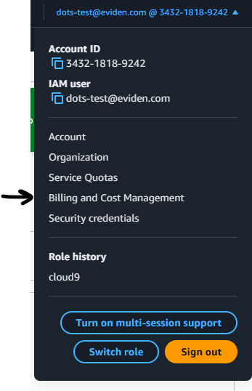
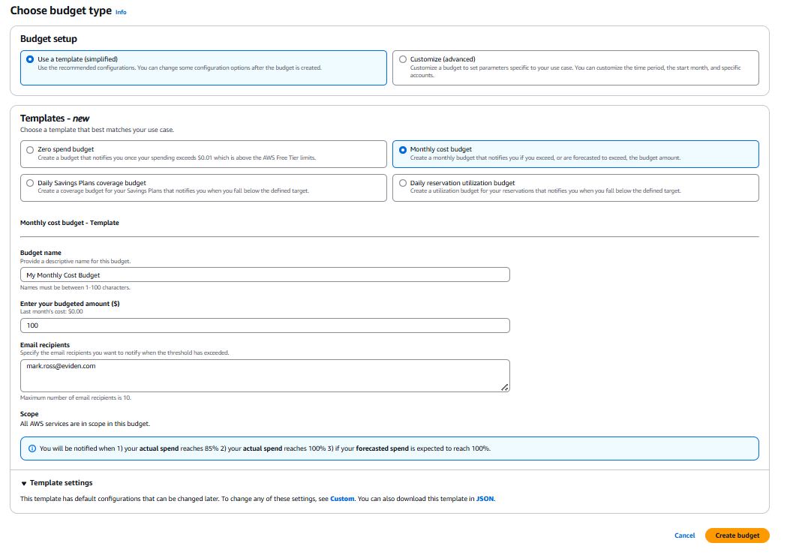
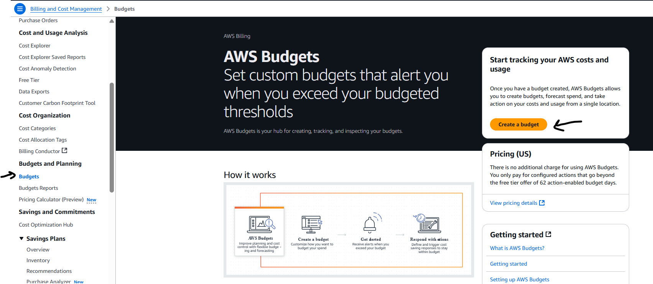
Enable Billing Alert
Manage your cost – accounts which are ‘abused’ may forfeit a finals place
Navigate to ‘Billing and Cost Management’ from your name and account number in the top right
On the left hand side navigate select ‘Budget’s and the press the ‘Create a Budget’ button
Select ‘Use a Template’ and ‘Monthly Cost Budget’. Give your budget a name, enter an amount and your email address to receive notifications and press ‘Create Budget’. Note – notifications for ‘Forecast Spend’ are quite crude and based on monthly spend to date extrapolated. If you receive one of these it’s best to review your actual spend and just consider your usage
You can monitor your spend (roughly 24 hours in arrears) in Billing and Cost Management

Slide 32
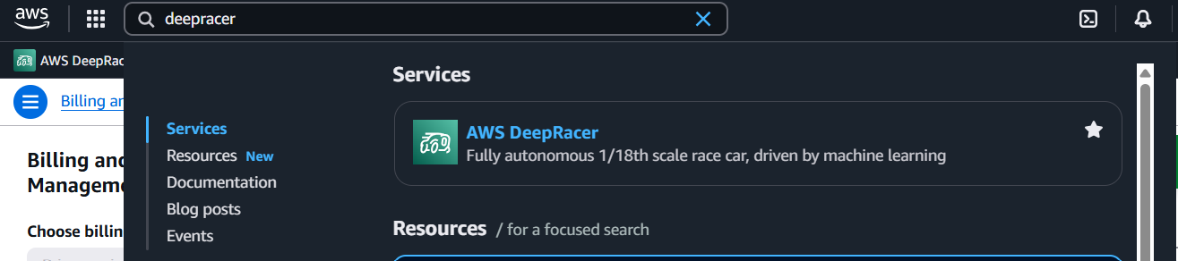
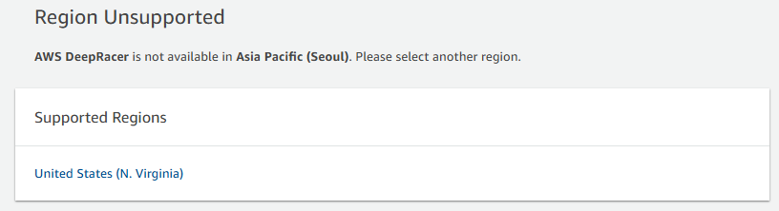
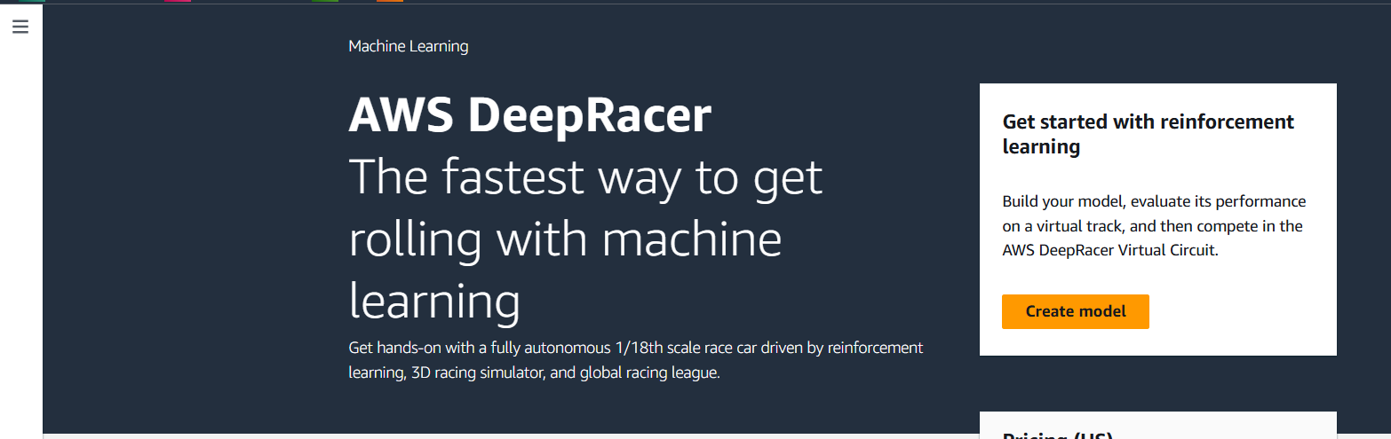
Setup DeepRacer Profile
In the search bar at the top of the console type deepracer and select the AWS DeepRacer service
Select United States (N. Virginia)
If everything is successful you should be presented with the following screen
Select the 3 lines in the top left and choose ‘Your racer profile’
Edit your profile and enter your details (Feel free to use a fun name but we need to be able to identify you if you make the finals – note you’ll need a unique name and not something you may have used previously)
Modify your avatar if you’d like and add any other requested information

Slide 33
Entering Your Regional Race
Join and submit entries to your regional race
Join only one of these races, depending on which city you registered as your closest
London - https://us-east-1.console.aws.amazon.com/deepracer/home#raceToken/1nQyIukfSSCfpJFKtOp9Sg
Paris – https://us-east-1.console.aws.amazon.com/deepracer/home#raceToken/_W93EWcKSPKhzpq38hOGPA
Bydgoszcz – https://us-east-1.console.aws.amazon.com/deepracer/home#raceToken/O3_6J1PeRl2OU6ZR_sCV5Q
Pune - https://us-east-1.console.aws.amazon.com/deepracer/home#raceToken/u1YRP27fTOSyndnmapUxTw
Important Notes: -
You may submit as many entries to your race as you like
We’re likely to only be able to take the top 30-35 racers forward to the physical racing in each city
The races are average lap format – this rewards stability, rather than a ‘lucky’ single lap

Slide 34
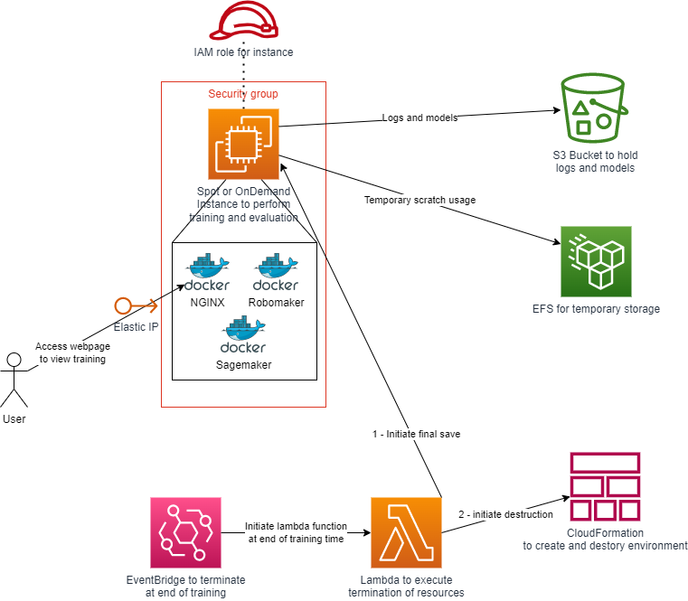
DeepRacer on the Spot Solution Overview
DeepRacer on the Spot (DOTS) provides an Infrastructure as Code solution to deploy DeepRacer into AWS EC2 instances (Spot or On-demand – note DOTS calls on-demand ‘standard’ instances)
Training happens on multiple docker containers with an NGINX container providing a website for you to monitor your progress, as well as inflight log analysis
Training logs are stored in S3 for later analysis
Models are auto uploaded to the AWS DeepRacer console upon completion of your training
On-demand instances won’t be interrupted
Spot instances are 50-80% cheaper to run, but could be interrupted (DOTS will continue training from where it left off in the event of interruption, it’s recommended to use spot to make your budget go further)

Slide 35
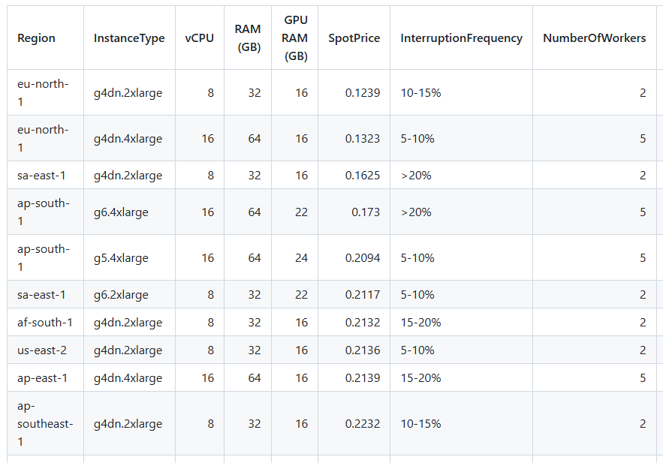
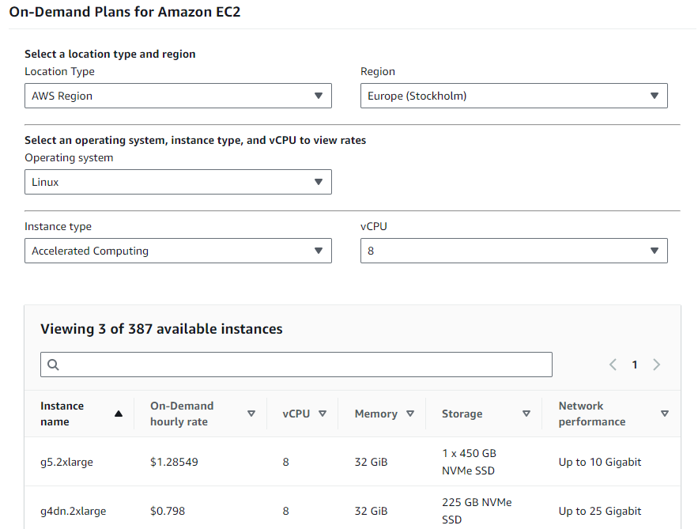
Check Instance Pricing
Prior to choosing a region it’s recommended to compare instance costs and historical spot pricing
Standard Instance Pricing per region can be found on the AWS website or pricing calculator, and daily updates are provided in the DOTS repo here
Also check on likelihood of interruption here so you choose a region with a good blend of price and low interruptions, daily interruption updates are also provided in the DOTS repo here
Spot Instance Pricing is a ‘marketplace’ that can dynamically change so it’s worth keeping an eye on changing pricing over the course of the competition.
You can only use one of the following regions – eu-north-1, ca-central-1, ap-northeast-3, ap-south-1, us-east-1, us-east-2, eu-central-1, eu-west-1, us-west-2, eu-west-3, sa-east-1, ap-southeast-3, eu-south-1

Slide 36
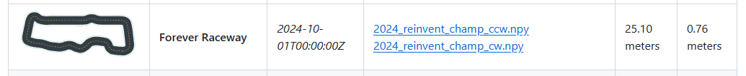
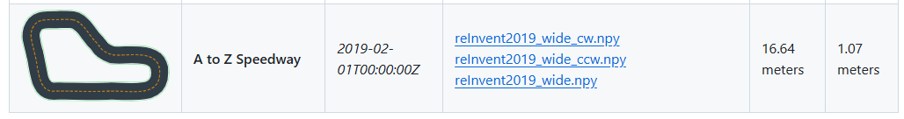
Take part in the competition
The correct tracks for each city are: -
London - 2024_reinvent_champ_ccw
All other cities – reInvent2019_wide_cw
You’ll be limited to $30 of spend for the qualifiers
You could train more models for less time
Or fewer models for more time
Recommend you start with an hour or two and then build on that model if it’s going well via cloning to see if you’re along the right path
If you need any support during the competition, please visit the dedicated channel in Teams

Slide 37
Initial DeepRacer on the Spot set-up
Choose how you’d prefer to consume
If you already have an Integrated Development Environment you use, feel free to use that
You may need to install some pre-reqs like the AWS Command Line Interface (CLI)
Skip setting up the SageMaker Studio Labs access unless you intend to do log analysis later
If you don’t already have an Integrated Development Environment, then follow the instructions to setup SageMaker Studio Labs to get a free cloud hosted environment

Slide 38
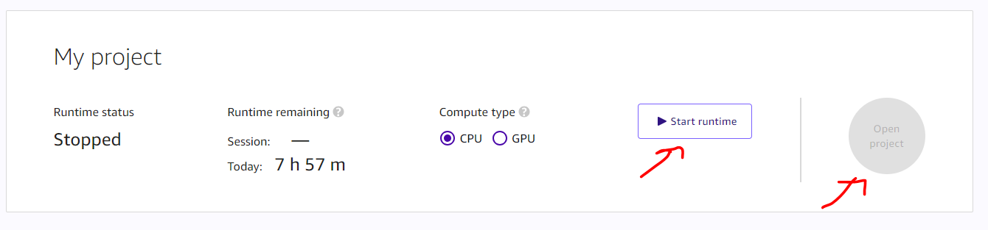
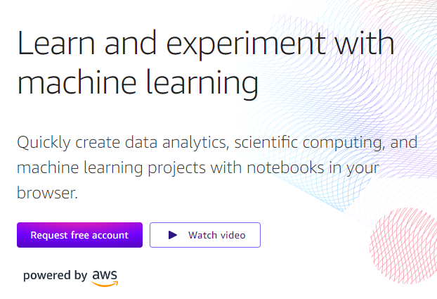

Sign-up for Sagemaker Studio Lab – free access to Jupyter Notebooks
Register at https://studiolab.sagemaker.aws/ for free access to Jupyter notebooks and check your email to verify the email address you used
Typically 24-48 hour wait before you will get an account - keep a look out in your email
Choose CPU compute type, press ‘Start Runtime’, entering your mobile number if required and verifying the OTP, and then once started press the ‘Open Project’ button
If capacity is used, you can try again later
Once logged in you should see a screen similar to this

Slide 39





Configure SageMaker Studio Access for DeepRacer on the Spot
Select ‘File’, ‘New’ and then ‘Terminal’
In the terminal type ‘git clone https://github.com/aws-deepracer-community/deepracer-on-the-spot.git’
Then type ‘cd deepracer-on-the-spot’ in the terminal
Having decided what region you want to do your training in type ‘export AWS_DEFAULT_REGION=<region>’, e.g.: -
Now authenticate your Terminal session with your AWS credentials by logging into https://deepracer-aws-eviden.awsapps.com/start#/ using your Eviden or Atos single sign-on credentials
Find your account and click ‘Access keys’
Press the button to copy the ‘Option 1’ credentials (note these credentials are valid for 1 day, or when you close the session, after which repeat these step to reauthenticate)
Paste settings into the command line to authenticate
Type ‘aws s3 ls’ to check it works, you should get no error message

Slide 40


Configure Base Stack
The base stack configures your AWS environment to allow training to occur, creating an S3 bucket to save your models, permissions for your training to run and requests ‘Quota’ to run EC2 virtual machines with GPUs
Type in the terminal ‘./create-base-resources.sh <base-stack-name> <your-public-ip>’ (you can get your public ip from https://whatismyipaddress.com/), then wait for the configuration to complete. e.g.: -
Navigate to AWS support and add justification to both of your quota requests – ‘I’m participating in an AWS DeepRacer competition using G series instances. I work for an AWS Partner, Atos. Please approve this request.’ (check back, this can take 24 hours and you can’t start training until at least one of them has been approved).

Slide 41



Configure Notification Stack
The notification stack ensures you get email notifications regarding your training – e.g. when it starts, ends, is interrupted or when there is an issue
Type in the terminal ‘cd scripts’ and then ‘./add-interruption-notification-subscription.sh <base-stack-name> <interruption-stack-name> <your-email-address>’, then wait for the script to complete, e.g. –
Navigate to your email client and accept the notification subscription

Slide 42


Configure Add Access Stack (Optional)
The add access stack allows you to access your training from additional locations, perfect if you want to check you training during the day in the office but from home at other times
Within the ‘scripts’ directory type ‘./add-access.sh <base-stack-name> <add-access-stack-name> <your-public-ip>’, then wait for the script to complete, e.g. -

Slide 43


Configure your Model
Edit the files to configure your model for training
Open the ‘deepracer-on-the-spot’ folder
Then open the ‘custom-files’ folder
The README.md file explains the files
For basic training utilize the files in the root of the ‘custom-files’ folder, editing them to meet your use-case
‘Reward-fn-examples’ folder provides some example reward functions – you could copy the contents of one into reward_function.py if you wanted to base yours on one of them
‘sac-example’ can be ignored – we advise you use the ppo algorithm which is the default
‘multitrack-example’ folder is an advance use case showing how each worker can be trained on different tracks – this can be useful for physical racing when you’ve already learnt how to develop models with a single track
For tips on editing each file see the next slides – note you can either edit the slides directly or take copies of them to refer to later – but when you run the training stack it will pick up the files in the ‘custom-files’ directory
Note - double clicking on a ‘json’ file doesn’t open it in the editor – you must right click on them and select ‘Open with’ and then ‘Editor’

Slide 44

Configure your Model – hyperparameters.json
Edit the files to configure your model for training
Batch size – supported values 32, 64, 128, 256, 512. Controls the size of the experiences the model learns from – lower trains quicker, higher gives more optimal results
Beta Entropy – supported values 0.0 – 1.0. Controls randomness added to model to explore, recommend leaving as 0.01
Discount factor – supported values 0.0 – 1.0. Controls how far into the future the model considers it actions. Smaller value makes model more aggressive, larger number can make a model too slow. 0.95-0.99 is a good area to try.
Learning Rate (lr) – supported values 0.00000001 – 0.001. Controls how much the model adjusts from its recent experiences, too low and training takes too long, too high and training doesn’t find optimal results. A value within 0.00005 – 0.0001 is likely to be suitable for the complexity of our tracks
Num episodes between training – Whole numbers supported. Controls how many attempts the car makes around the track before updating the model. Note – to ensure evaluations start from the start/finish line the calculation of other configured items must be ( num_episodes_between_training / DR_WORKERS) * DR_TRAIN_ROUND_ROBIN_ADVANCE_DIST = 1.0 (the defaults for these values are (40/2) * 0.05 = 1.0.
Num epochs – supported values are whole numbers 3 – 10. Controls the number of times the model update process passes over your data. Recommended to leave at ’10.
E Greedy, epsilon steps, exploration type and loss type – recommend leaving as default

Slide 45



Configure your Model – model_metadata.json
Edit the files to configure your model for training
Action space type – supported values are discrete or continuous. It is recommended to use discrete as training is quicker and you can avoid adding high speed high steering angle actions that may result in spinning
Action space
For discrete you provide a list of objects in the format show, each object is a combination of steering angle (-30 – 30 supported) and speed (0.1 – 4.0 supported). It’s recommended you have actions with various speeds and steering angles. The default settings are not recommended as they have limited angles and a slow maximum speed
For continuous you provide ranges and the model makes decision on what angles and speeds to take
Sensor, neural network, training algorithm and version – recommend leaving as default

Slide 46

Configure your Model – reward_function.py
Edit the files to configure your model for training
Write your reward function in python
Supported inputs are defined here
Above the reward function you can define global variables that you can update inside your reward function it you want to store ‘state’ between each step

Slide 47

Configure your Model – run.env
Edit the files to configure your model for training
Only edit the following settings: -
DR_WORLD_NAME – set it to ‘2024_reinvent_champ_ccw’ for London or ‘reInvent2019_wide_cw’ for other cities
DR_TRAIN_ALTERNATE_DRIVING_DIRECTION – optionally you can set this to ‘TRUE’ to train in both directions on the track, useful for making generalised models for physical racing
DR_TRAIN_ROUND_ROBIN_ADVANCE_DIST – leave as default unless you have changed the number of workers (DR_WORKERS in system.env) or the number of episodes between training (num_episodes_between_training in hyperparameters.json), in which case make sure the calculation (num_episodes_between_training / DR_WORKERS) * DR_TRAIN_ROUND_ROBIN_ADVANCE_DIST = 1.0
DR_LOCAL_S3_MODEL_PREFIX – set the last part of the value to the name of your model, e.g. change ‘first-model’
DR_LOCAL_S3_CUSTOM_FILES_PREFIX - set the last part of the value to the name of your model, e.g. change ‘first-model’
DR_UPLOAD_S3_PREFIX - set the last part of the value to the name of your model, e.g. change ‘first-model’
DR_REGULAR_UPLOAD – change to a value in minutes (e.g. 30) if you want to save checkpoints of your model as you go along (useful if you model ‘peaks’ and then gets worse over time)
DR_REGULAR_PHYSICAL_UPLOAD – change to a value in minutes (e.g. 30) if you want to save physical models as you go along (useful if you model ‘peaks’ and then gets worse over time)

Slide 48

Configure your Model – system.env
Edit the files to configure your model for training
Only edit the following settings: -
DR_WORKERS
Leave as default unless you have increased your instance size to a 4xlarge (in which case set the value to a max of 5) or 8xlarge (in which case set the value to a max of 10)
If you change this value also review or the number of episodes between training (num_episodes_between_training in hyperparameters.json) DR_TRAIN_ROUND_ROBIN_ADVANCE_DIST in run.env. The calculation must be (num_episodes_between_training / DR_WORKERS) * DR_TRAIN_ROUND_ROBIN_ADVANCE_DIST = 1.0

Slide 49

Configure your Model – multitrack training
Edit the files to configure your model for training
To train on multiple tracks simultaneously: -
Delete the original custom-files, and copy in the ones from ‘multitrack-example’
Select your number of workers in system.env ‘DR_WORKERS’
Run.env defines the main config and the config for the first worker
Subsequent workers get their config defined in worker-2.env, worker-3,env etc.
Be sure to configure the track via ‘DR_WORLD_NAME’ in each worker env file and run.env, a full list of tracks can be found here - https://github.com/aws-deepracer-community/deepracer-race-data/tree/main/raw_data/tracks

Slide 50


Training your Model – start your training
In the terminal ensure you’re in the ‘deepracer-on-the-spot’ directory
If required, set your region with export ‘AWS_DEFAULT_REGION=<region-you-want-to-use>’, e.g.: -
If required, visit the AWS webpage and re-authenticate by copying your credentials into the terminal: -
You now have two options, either run on a standard instance (which is more expensive, but guarantees zero interruptions), or a spot instance (which is significantly cheaper but could be interrupted).
Ideally you should run on spot instances, however if your spot instance quota hasn’t yet been approved by support, but your standard instance quota has, you may want to get started using standard instances
To use spot instances the script is ‘./create-spot-instance.sh’
To use standard instances the script is .create-standard-instance.sh.
The full command, using spot as an example is ‘./create-spot-instance <base-stack-name> <model-name> <time-in-minutes-for-training-to-run>’, e.g.: -

Slide 51
Check your standing in the race
Make sure you’re in the running
Ensure you’ve followed the instructions to join the race in your city
Navigate to ‘Community Race’ in the DeepRacer menu, and then select ‘Leaderboard’ for your race
If you don’t find your name in the leaderboard then use the ‘Enter Race’ button and follow the instructions to submit your model

Slide 52
Understanding Hyperparameters
06

Slide 53
Hyperparameters
Hyperparameters alone won’t make a great model, but they can ruin one!
In this section we talk about an ‘optimal’ results but it’s important to note optimal result means ‘highest reward’ – it’ll only mean ‘faster laps’ if your reward function align to that behaviour
Recommend to leave fixed: -
Training algorithm – Use PPO, as none of the ‘pro’ racers have had success with the alternative (SAC)
Number of epochs –Number of passes over the training data used between training episodes to update the model (the size of this training data is based on the batch size) and it is recommended to leave it at 10
Loss type – Use Huber, lots of people have great success with this
Number of episodes – this is designed to ensure the car starts on the start/finish line for each evaluation
Experiment with
Batch size – This controls the size of the previous episodes the model may use to update
Learning rate – How much the model can be updated between training episodes based on the results
Discount factor – How far into the future the model considers future actions whilst making decisions
Entropy – How much the model ‘explores’ (tries to find something better) versus ‘exploits (hones what it already learnt) – 0.01 is a good starting point but you may want to try above and below this

Slide 54

Hyperparameters
Batch size and number of Epochs are linked
Larger batch
Batch size – Smaller batch size means less episodes to learn from when updating, larger batch size has a bigger pool of episodes to update from
Number of epochs – larger numbers means the model update passes over a subset of the batch more times
Larger batch + larger number of epochs = model is more likely to learn from training episodes
(but takes longer to train)
Smaller batch

Slide 55



Hyperparameters
Batch size Examples – what’s the best batch size?
Depends on how much time you have if all other things are equal
Larger Batch Size

Slide 56

Hyperparameters
Larger discount factor
Discount Factor
Smaller discount factor
Future Discount Factor = (df)^{n} when n is the number of steps in the future. DF of 0.95-0.99 is worth exploring
If reward=1 at each step and df was 0.95 then current step = 1, next step = 0.95, one after that = 0.9025 etc.
Very large discount factors mean the future rewards being considered outweigh the impact of immediate decisions – this typically results in slow lap times
Very small discount factors means immediate rewards outweigh future rewards significantly – this typically results in never completing laps (e.g. the reward of going into a corner really fast is prioritised, as going off the track in a few steps time as it can’t steer round the corner isn’t factored into the calculation
How many steps ahead should I consider when making my decision?

Slide 57


Hyperparameters
Discount Factor – what’s the best discount factor?
Too low may result in more off tracks
Find a sweet spot
Too high and model may start slowing down
Larger Discount Factor

Slide 58

Hyperparameters
Learning rate too high – misses the optimal
Learning Rate
Ideal learning rate
The model learns from it’s training episodes, but learning rate controls by how much to avoid a good model becoming bad by wildly swinging from one extreme to another
The algorithm uses ‘gradient descent’ – with the optimal answer being the bottom
Too high a learning rate may result in being unable to complete a lap
Too low a learning rate may result in never reaching the optimal result
0.0001 - 0.00005 is probably a good range for this track – you can always clone and alter (typically lower)
Learning rate too low – never reaches optimal
Optimal

Slide 59



Hyperparameters
Entropy
Too low may result in slower improvement
Sweet spot
Too high and the results aren’t quite as good
Larger Entropy

Slide 60
Understanding Action Space
07

Slide 61


Action Space
High risk of sliding / spinning
Continuous action space
Continuous or Discrete
Continuous action space has near infinite possibilities
Training takes considerably longer
Many of the actions on offer are not physically possible and results in the car spinning (e.g. 30/-30 at 4m/s)
You can use your reward function to penalise these actions
Pro racers are using discrete actions
Discrete actions allow you to control what actions are allowed
Choose narrow angles with faster speeds
Choose tighter angles with slower speeds
Monitor car behaviour – e.g. spinning, sliding – power slides look great but are rarely fast!
More actions = potentially more optimal result
Fewer actions = less training time required
Discrete action space
Avoids actions that would cause a spin / slide

Slide 62
Understanding Reward Function
08

Slide 63



Reward Function
Optimising reward function continued
When using multiple input parameters ensure you consider their relativity
If you reward speed 10x more than position on track (e.g. centreline) the model will bias towards faster actions that give more reward regardless of track position, e.g.
Bad track position + going fast = large reward
Good track position + going slow = small reward
Helping the model to ‘learn’ in the right direction
Bands of reward can help (e.g. default centreline), but the model can struggle to optimise
Linear rewards encourage models to learn in a certain direction
Exponential rewards can encourage models to learn even more in a certain direction
https://www.geogebra.org/calculator is a great resource
Reward
Reward
Reward
Distance from centre
Distance from centre
Distance from centre
Default centreline model (approx.)
Reward = 1 – distance from centre
Reward = (1 – distance from centre)²

Slide 64


Reward Function
Advanced reward functions
You can import python modules before your reward function definition
The DeepRacer console supports importing
math
random
numpy
scipy
shapely
DeepRacer on the Spot isn’t limited on what imports are supported
You can initialise things outside the reward function and utilise them inside the reward function
I’m not saying adding a lap time bonus is a good idea, just that it can be done using this technique to store (an update) variables between steps

Slide 65
Analysing your performance
09

Slide 66

Analysing Performance
AWS DeepRacer Console
The AWS DeepRacer Console provides very limited opportunity to analyse your training data
You’re limited to a simple graph
You could evaluate your model – but this costs $3.50/hour
You can simply submit your model to the Atos race (after all submissions are unlimited)
None of these options will help you to understand ‘why’ your model is performing in the way it is
Console based graph
Lines are all going in the right direction – perhaps training ended too early

Slide 67





Analysing Performance
DeepRacer on the Spot
DeepRacer on the Spot contains live analysis, accessible within the UI
Grafana Dashboards provide detail about progress, reward, lap times and entropy (is you model getting more certain about its actions)
Jupyter Notebook pages also provide information on reward, lap completion, times and other metrics, as well as heatmaps and paths your model is taking

Slide 68



Analysis
Simple View
Suggests good correlation between
Increasing reward (green in console, not shown for DOTS)
Increasing training completion (blue)
Increasing evaluation completion (red in console, orange in DOTS)
Suggests poor correlation between
Reward (green)
Training completion (blue)
Evaluation completion (red)
Likely to be a suboptimal reward function
Important – these graphs show whether convergence is achieved (i.e. able to complete a lap), they don’t give an indication whether a fast lap time can be achieved

Slide 69




Detailed Analysis
DeepRacer Analysis
For Console (Console Notebook) and DOTS (Metric Notebook) users ‘Best Lap Progression’ is indicative of whether a converged model is getting faster or slower lap over time
Example model learning to get slower over time
Example model learning to get faster over time
Training Analysis Notebook can be insightful
Stats for complete laps (reward), example showing no correlation between overall lap time and reward, which isn’t’ an exact science
May result in model not improving over time (5th quintile is last 20% of training)

Slide 70





Detailed Analysis
DeepRacer Analysis
Heatmaps can be used to show where on the track the most reward is being issued
Centreline
Not centreline…
Training Analysis Notebook can be insightful in showing where your model is struggling too
Train starts at various points around the track, where you see a graph like this it suggests the model is struggling between waypoints 70-100
Section struggling to complete

Slide 71


Detailed Analysis
DeepRacer Analysis
Stalled progress doesn’t necessarily mean it’s a bad model, it could mean it’s taking a while to figure things out
You could of course run out of time to find this out though
You probably want to be confident in your strategy to play this game
Training Analysis Notebook can be insightful
Stats for complete laps (reward), example showing no correlation and correlation between overall lap time and reward, which isn’t’ an exact science
Lower correlation may result in model not improving over time (5th quintile is last 20% of training)
+time could =

Slide 72



Detailed Analysis
DeepRacer Analysis
Visual Analysis – how certain is the model getting over time?
Less actions chosen with higher probability = converging model
Action Space Analysis – which actions lead to fast laps?

Slide 73
Uploading models for the Physical Racing
10

Slide 74

Download your physical models for the finals
AWS DeepRacer Console Users
Navigate to the DeepRacer console
Select the model you want to use
Choose ‘Actions’
Choose ‘Download physical car model’
The file should download to your usual download location and be approx. 20MB in size
The file will be named <model name>-model.tar.gz (Note – some operating systems drop the .gz, if your file is missing the .gz extension simply rename the file to add .gz to the end)
Repeat for each model you want to use in the finals

Slide 75

Download your physical models for the finals
DeepRacer on the Spot Users
Navigate to the S3 console
Select the S3 bucket created by your ‘base resources’ script and the folder name for the model you want to use
Select ‘model.tar.gz’ and press ‘download’
The file should download to your usual download location and be approx. 20MB in size
If you’re submitting multiple models to the finals you will need to rename the downloaded file to something unique, e.g. model1-model.tar.gz or centerline-model.tar.gz (Note – some operating systems drop the .gz, if your file is missing the .gz extension simply rename the file to add .gz to the end)
Repeat for each model you want to use in the finals

Slide 76


Register for DeepRacer Event Manager
Navigate to DeepRacer Event Manager (DREM) - https://eventmanager.deepracer.aws.eviden.com
Switch the tab to ‘Create Account’, complete the self-registration and press ‘Create Account’
Check your email for the code to verify your DREM account, enter it in the checkbox and press ‘Confirm’
You’re now registered and logged into DREM, subsequent use you don’t need to re-register and can simply use ‘Sign In’ on the first page

Slide 77




Upload your models to DeepRacer Event Manager
Navigate to DeepRacer Event Manager (DREM) - https://eventmanager.deepracer.aws.eviden.com
Choose ‘Models’
Choose ‘Upload Model’
Choose the model(s) you want to upload and press ‘Open’
Wait for upload to complete
Repeat for all models you want to use in the finals
Note – if model fails to upload check file has tar.gz extension
That’s it, you’re ready for the finals!

Slide 78
Thank You
For more information please contact: -
Mark Ross
mark.ross@atos.net
Simon Hill
simon.hill@eviden.com

